Slide 1

Big Data Master Class Graduation Project
By Rowan Hazem Wagieh
rowanhazem@gmail.com

Slide 2

AGENDA
DATA INGESTION
DATA STORING
DATA PROCESSING & ANALYSIS
THE OUTPUT FILE
DATA VISUALIZATION
AUTOMATION USING OOZIE

Slide 3
DATA INGESTION
The first stage is the data ingestion:
Which means to have the data on your machine (in our case it’s the virtual machine) to start the work.
It’s done by simply copying the file covid-19.csv from the local machine and paste it on the virtual machine using CTRL+C & CTRL+V.
The covid-19.csv file is copied to the directory: /home/cloudera/covid_project/landing_zone

Slide 4
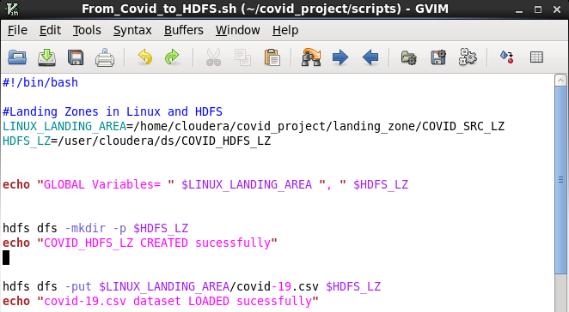
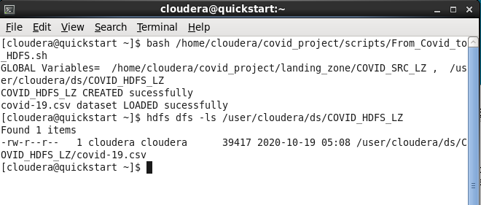
DATA STORING
HDFS script:
HDFS commands:
The second stage is the data storing where we load the covid-19 csv file into HDFS to be able to work with:
A directory is made to hold the input file which is: /user/cloudera/ds/covid_HDFS_LZ
Then the file is simply loaded into HDFS as shown in the upper screenshots

Slide 5
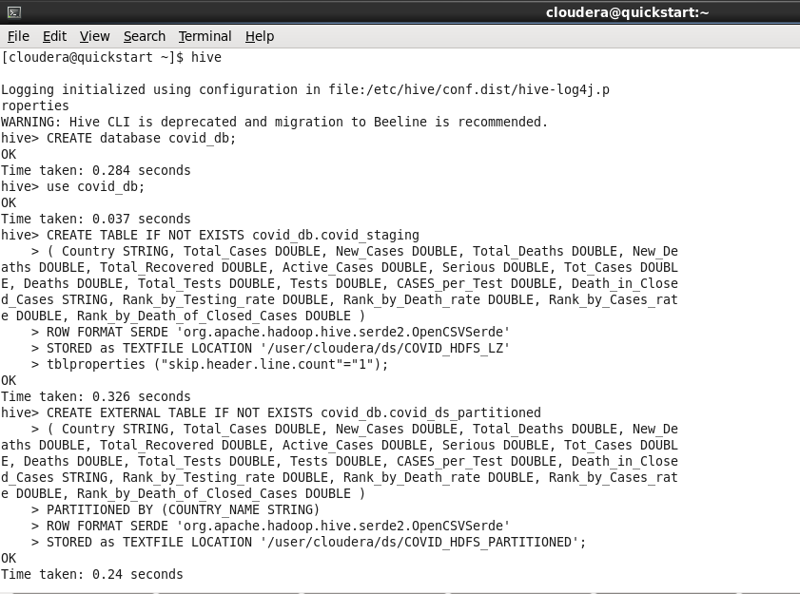
DATA PROCESSING & ANALYSIS
covid_staging table creation commands:
Thirdly is the data processing & analysis stage :
The data processing:
First, a database was created to store the data in.
Second, table covid_staging is created and was filled by the file that was created in the HDFS, and any commas or quotations were removed by using row format serde .
Third, table covid_ds_partitioned is created and was filled by the data in table covid_staging but the difference was that we used partitioning by country so it’d make the queries faster, but to be able to do that we had to make some changes in hive variables so 4 set commands was used as shown in the next screenshots.

Slide 6
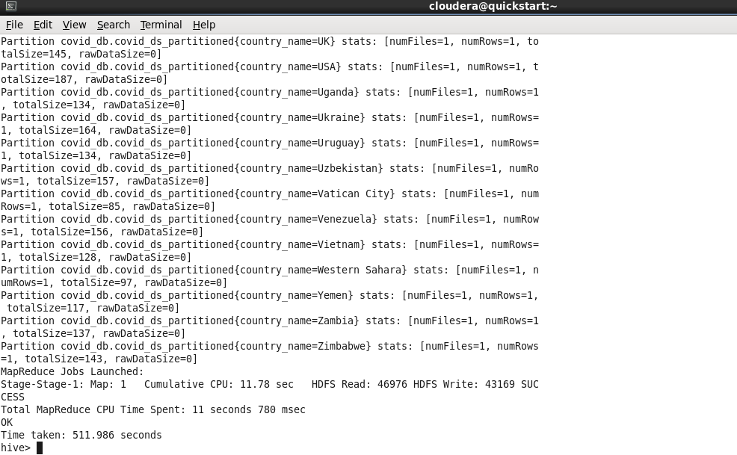
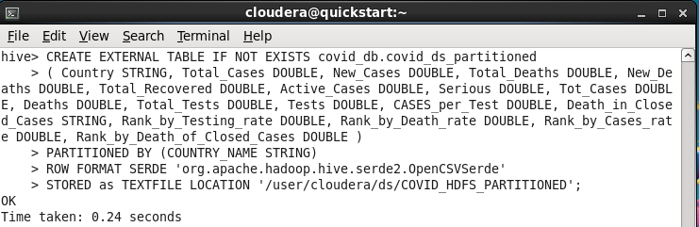
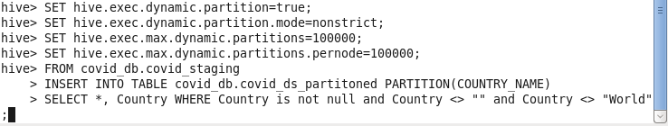
covid_ds_partitioned table creation commands and setting the environment in hive:
The output of the partitioning:

Slide 7
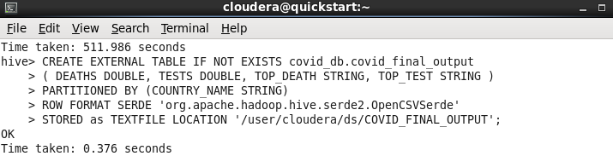
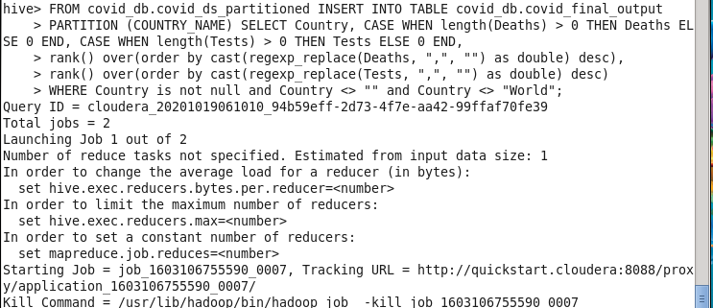
CONT. DATA PROCESSING & ANALYSIS
covid_final_output table creation commands:
Then:
The data analysis:
Table covid_final_output is created and was filled by some of the data in table covid_ds_partitioned.
All the null values were replaced by 0 value.
The rank() function was used so that we can rank the countries according to Deaths and Tests values, so columns TOP_DEATH and TOP_TEST contains the rank of each country.

Slide 8
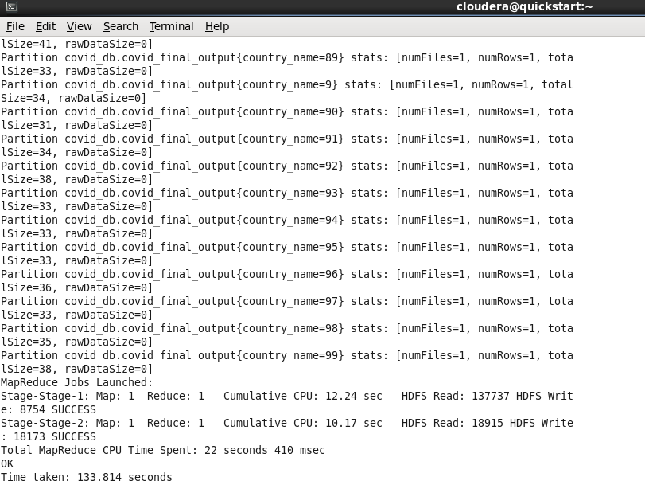
The partitioning and filling of covid_final_output:

Slide 9
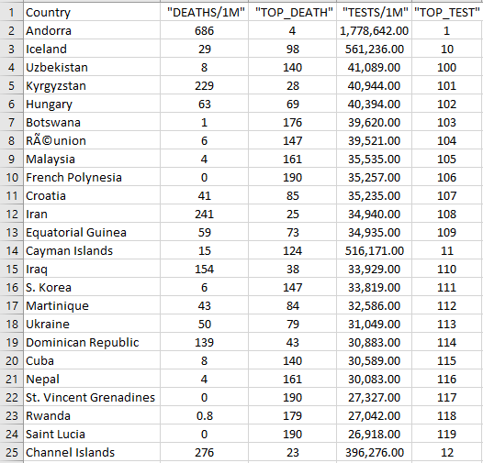
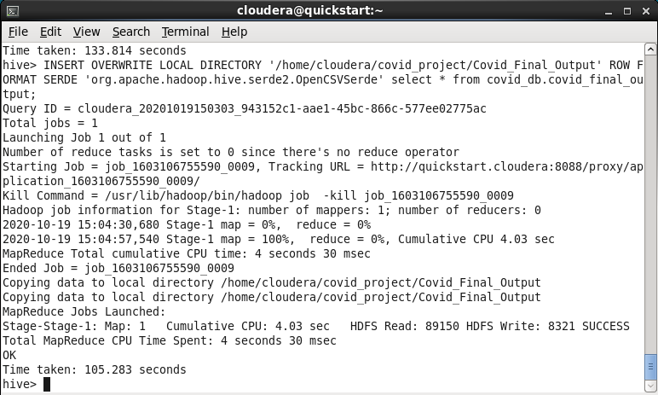
THE OUTPUT FILE
Here is a screenshot of part of the output file that was exported from hive into a csv file.
Exporting the table into a file commands:

Slide 10
DATA VISUALIZATION
The fourth stage is the visualization:
First, the csv file that was made from the previous stage is used to visualize the data by using Power BI tool.
The second visualization is also a map but instead it contains the top 10 ranking countries in test rate.
The third visualization is like the second one but instead it’s a pie chart not a map.
The fourth visualization is a table that contains the country name as “Country”, death rate as “DEATH/1M” , the ranking of each country according to the death rate as “TOP_DEATH”, test rate as “TEST/1M”, and finally the ranking of each country according to the death rate as “TOP_TEST”

Slide 11
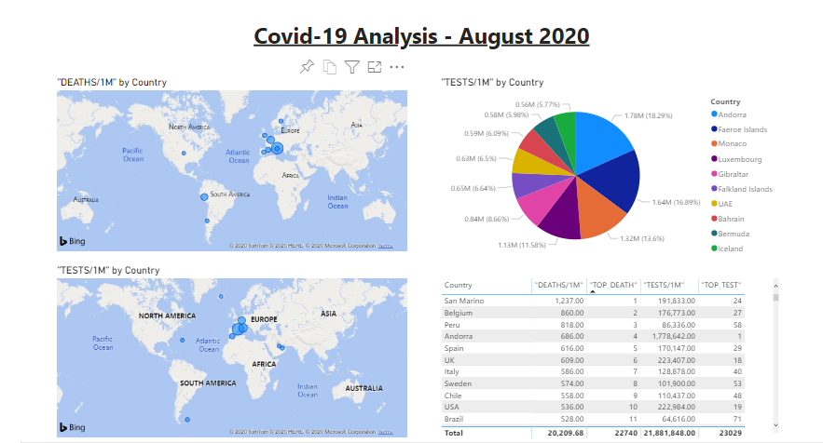

Slide 12
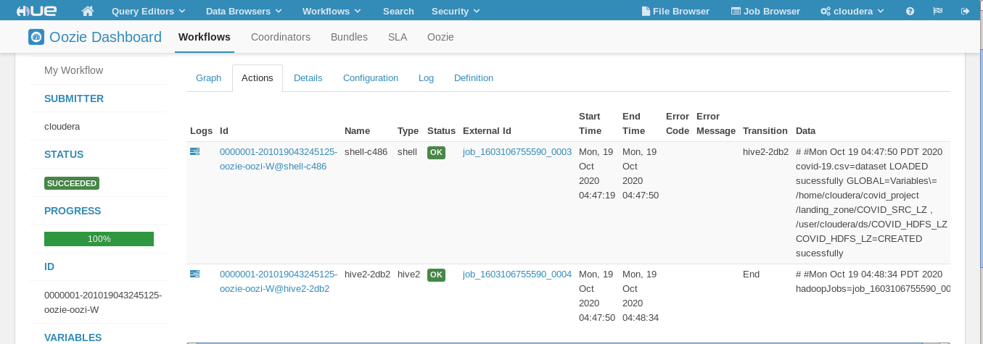
Automation Using OOZIE
It’s the last thing is where OOZIE is used to automatically run the HDFS and HIVE scripts as a pipeline instead of doing it manually.

Slide 13
THANK YOU !

